Slide 1

Introduction
Funnel Analysis
Conclusion
METROCAR
FUNNEL
ANALYSIS
PROJECT

Slide 2

MetroCar
Introduction
Funnel Analysis
Conclusion
METROCAR
INTRODUCTION
Project Focus: Comprehensive funnel analysis of Metrocar, a ride-sharing app.
Objective: Identify drop-off points and optimize the customer experience.
Tools Used:
SQL for data extraction
Pandas for data manipulation
Plotly for visualizations
Notes:
In this project, we will conduct a comprehensive funnel analysis of Metrocar, a ride-sharing app, to evaluate its customer journey from app download to ride review.
Our aim is to identify key drop-off points and optimize the customer experience by analyzing user behavior at each stage of the funnel: app download, signup, ride request, driver acceptance, ride completion, payment, and review.
We will leverage SQL for data extraction and Pandas for data manipulation, with visualizations crafted using Plotly to illustrate insights.

Slide 3
Metro Car
Introduction
Funnel Analysis
Conclusion
METROCAR
FUNNEL ANALYSIS
App Download: User downloads the Metrocar app.
Signup: User creates an account with necessary details.
Request Ride: User requests a ride by entering pickup and destination details.
Driver Acceptance: A driver accepts the ride request.
Ride: The ride is completed from pickup to dropoff.
Payment: User is charged automatically, and a receipt is issued.
Review: User rates the driver and provides feedback.
Notes:
The funnel analysis stages for the Metrocar app are: App Download, Signup, Request Ride, Driver Acceptance, Ride, Payment, and Review. This sequence tracks the user journey from initial app installation through to providing feedback, helping identify key touchpoints and potential drop-off points in the user experience.

Slide 4
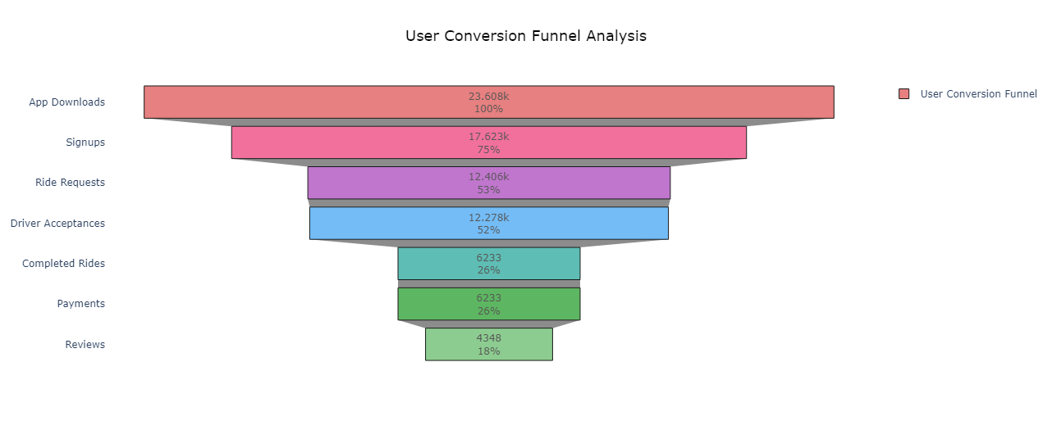
Metro Car
Introduction
Funnel Analysis
Conclusion
Funnel Stage Analysis
User Conversion Funnel Analysis
Highest drop-off – 49.23% - Completed ride stage
Notes:
The highest drop-off occurs at the ride stage (49.23%), indicating a major issue with ride fulfillment. Signup (25.35%) and request ride (29.60%) stages also see significant drop-offs, suggesting potential barriers. The payment process is smooth with no drop-off, but many users skip the review stage (30.24%).

Slide 5
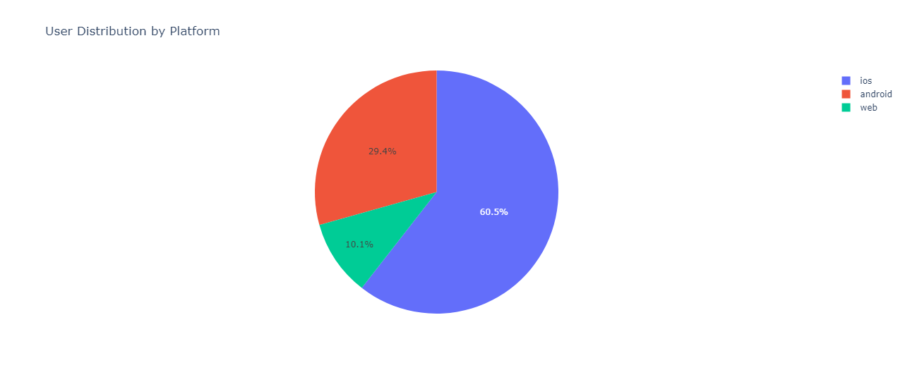
Metro Car
Introduction
Funnel Analysis
Conclusion
Funnel Stage Analysis
User Distribution by Platform
Notes:
iOS users make up the majority of the user base at 60.5%, significantly outpacing Android and web users. Android follows with 29.4%, while web users represent only 10.1% of the total, suggesting a strong focus on optimizing the iOS platform and increasing engagement on Android and web platforms.

Slide 6
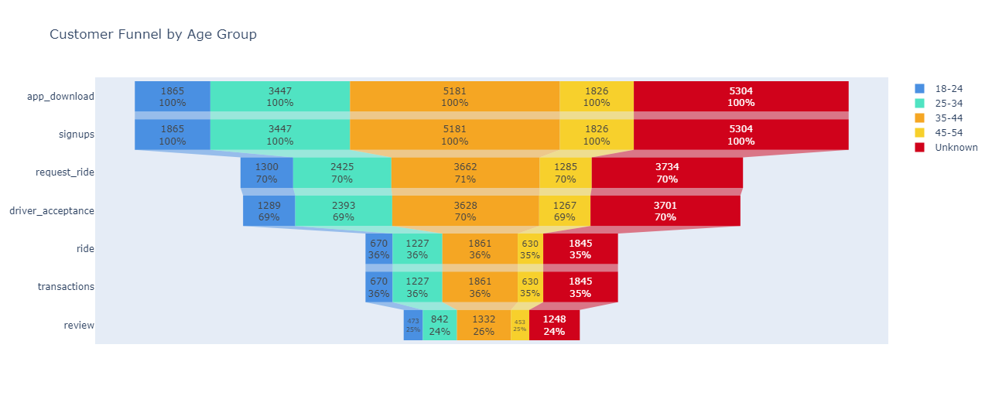
Metro Car
Introduction
Funnel Analysis
Conclusion
Funnel Stage Analysis
Customer Funnel by Age Group
"Approximately 5,985 app downloads and 5,304 user records have null or unknown age range values."
Notes:
The age group 35-44 performs best at every stage of the funnel, indicating strong engagement and success from app download to review. Targeting this demographic with tailored marketing and features could further enhance user experience and conversion rates.

Slide 7
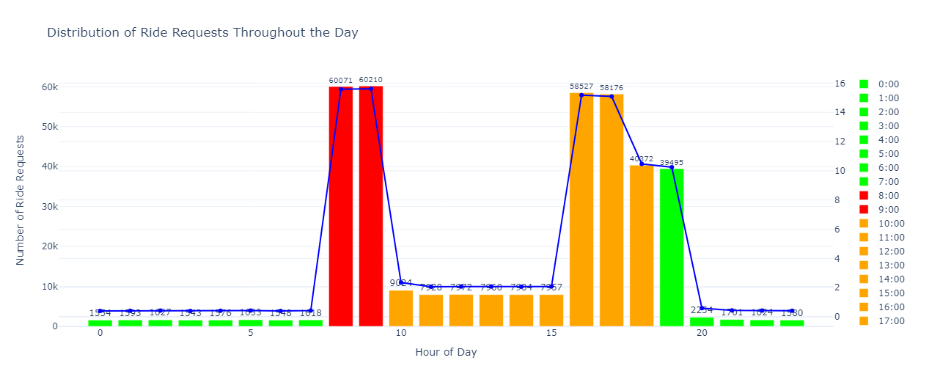
Metro Car
Introduction
Funnel Analysis
Conclusion
Funnel Stage Analysis
Distribution of Ride Requests Throughout the Day
Notes:
To implement a price-surging strategy effectively, apply higher surge pricing during peak hours (8 AM - 9 AM) to capture high demand while using moderate pricing from 12 PM to 7 PM to manage steady demand. Avoid surge pricing during low-demand hours (2 AM - 5 AM and 10 PM - 2 AM) to prevent customer deterrence.

Slide 8
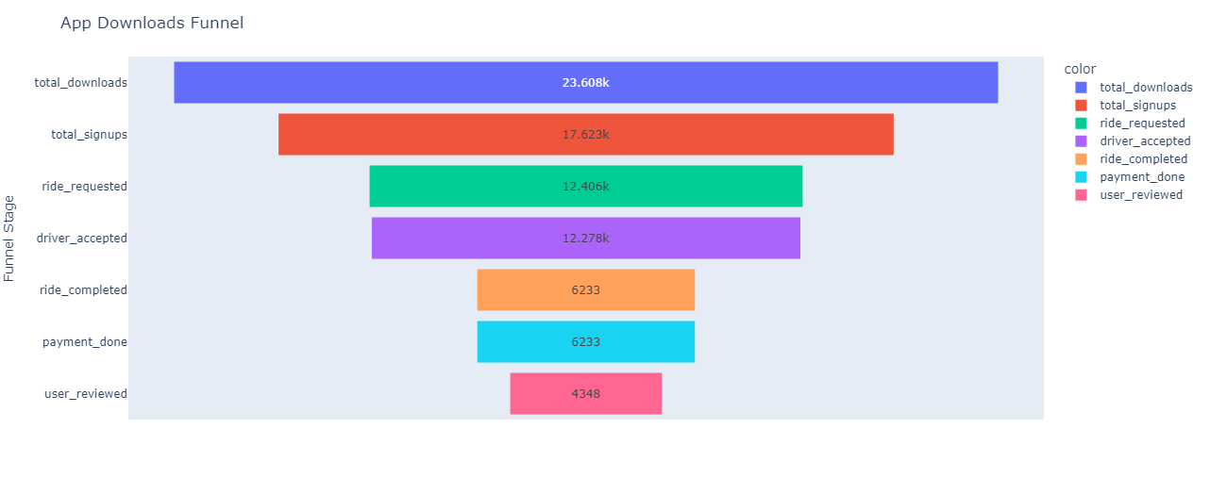
Metro Car
Introduction
Funnel Analysis
Conclusion
Funnel Stage Analysis
App Downloads Funnel
Notes:
The stage in our customer funnel with the lowest conversion rate is the 'ride_completed' stage, which has a conversion rate of just 0.51%. This metric indicates that only a small fraction of users who request a ride ultimately complete it. This low conversion rate is a significant concern because it suggests that a substantial number of users drop off before finalizing their ride.

Slide 9
Metro Car
Introduction
EV Technology
Conclusion
RECOMMENDATIONS
Simplify the signup process
Allocate marketing resources
Target age groups with higher conversion rates
Enhance ride requests and driver acceptance
Introduce surge pricing during peak demand periods
Notes:
Simplify the signup process to reduce drop-offs from app download to account creation by minimizing required fields and integrating social media logins.
User feedback should be concentrated on improving interactions and enhancing usage retention across all platforms.
Target age groups with higher conversion rates by tailoring marketing efforts and app features to appeal to these demographics, improving overall funnel performance.
Enhance ride requests and driver acceptance by refining the ride-matching algorithm and providing incentives for faster driver responses to reduce cancellations and improve user experience.
Introduce surge pricing during peak demand periods identified through ride request data to optimize revenue and balance supply with high-demand times.

Slide 10

Metro Car
Introduction
EV Technology
Conclusion
CONCLUSION
Based on the analysis, actionable recommendations have been made to enhance Metrocar’s overall customer experience and operational efficiency.
Notes:
The funnel analysis will reveal critical insights into user behavior at each stage of the customer journey, enabling targeted strategies to optimize user engagement, improve conversion rates, and allocate marketing resources effectively. Based on the analysis, actionable recommendations have been made to enhance Metrocar’s overall customer experience and operational efficiency.

Slide 11

Presented By:
Anju Thomas
Moritz Panni
Sushma Rai
Swathy Krishna
Vanshika Singh

